Slide 1
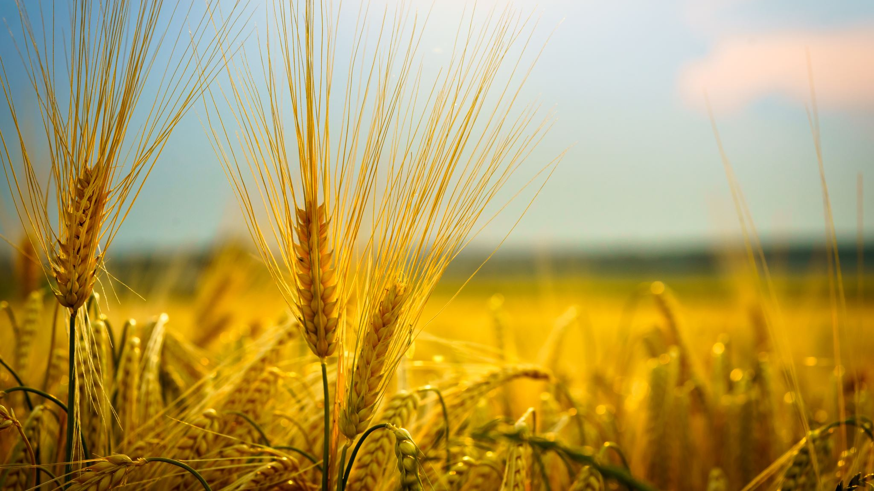
SmartRust AI for Wheat Disease Detection and Prevention

Slide 2
About Us
Presented by:
M.Faseeh ur Rehman
Rehan Tariq
Fahad Imran
Supervisor :
Mr.Almaas Mazoor
Department of Software engineering
The University of Lahore

Slide 3
Contents
Introduction
Problem Statement
Objectives
Features
Vision
Mission
Tools and Techniques
Methodology
Results
Conclusion

Slide 4
Introduction
Wheat leaf diseases like yellow rust, brown rust, and black rust are fast-spreading fungal threats that significantly impact wheat yield and quality. Traditional detection methods are slow and labor intensive. This project aims to develop a technology-driven solution for early detection and effective management to promote sustainable wheat production.
The system will empower farmers with instant diagnostics and actionable recommendations using AI-based image analysis.

Slide 5
Problem Statement
Traditional manual methods for detecting wheat leaf diseases are slow and inaccessible to many farmers, risking significant crop losses. This research compares InceptionV3 and a custom deep learning model using 5,000 high-resolution images to identify the most accurate approach for classifying wheat rust (brown, yellow, black) and healthy leaves. The aim is to support real-world deployment in precision agriculture.

Slide 6
Objectives
Develop a machine learning model for disease classification.
Ensure over 98% accuracy in disease detection.
Provide a user-friendly interface for farmers.
Deliver real-time results and treatment recommendations.
Conduct field trials to validate effectiveness.

Slide 7
Features
AI-based detection of yellow, brown, and black rust.
User-friendly web interface for image upload and instant results.
Real-time disease classification with treatment recommendations.
Responsive design for mobile and desktop devices.
Secure data handling and user authentication.

Slide 8
Vision
To revolutionize crop disease management by providing farmers with accessible and intelligent AI tools that enhance productivity, ensure food security, and promote sustainable agriculture.

Slide 9
Mission
To empower farmers through technology by delivering an accurate, efficient, and user-friendly AI system for early detection, classification, and treatment of wheat leaf diseases.

Slide 10
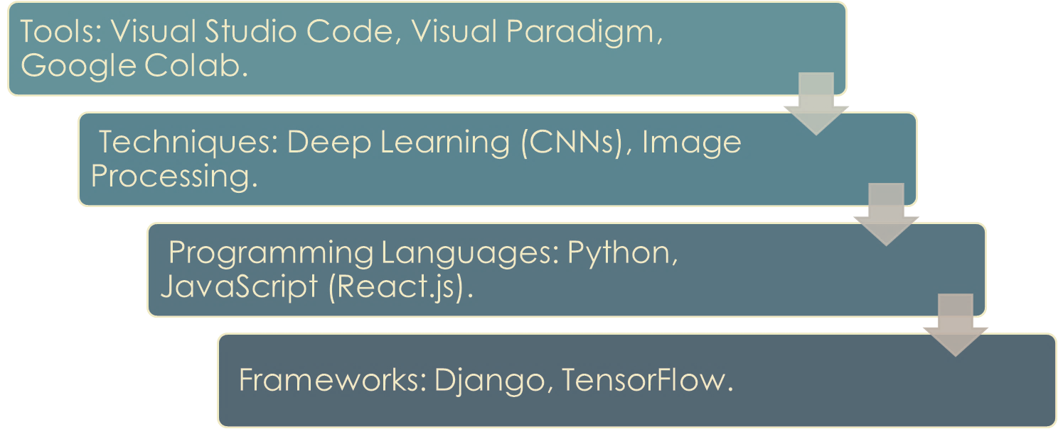
Tools and Techniques

Slide 11
METHODOLOGY
Dataset preparation with labeled disease images.
Model training using CNN for image classification.
Backend integration using Django and TensorFlow.
Frontend development in React.js.
System testing and validation through field trials.

Slide 12
Models (InceptionV3)
Architectural Innovation: InceptionV3 is a deep neural network architecture that introduced the concept of "inception modules" with parallel convolutional operations.
Feature Extraction: Known for efficient feature extraction through the use of multiple filter sizes within the same layer, enabling the network to capture diverse patterns.
Image Recognition: Widely employed for image recognition tasks, InceptionV3 balances model complexity and computational efficiency, making it suitable for various computer vision applications.

Slide 13
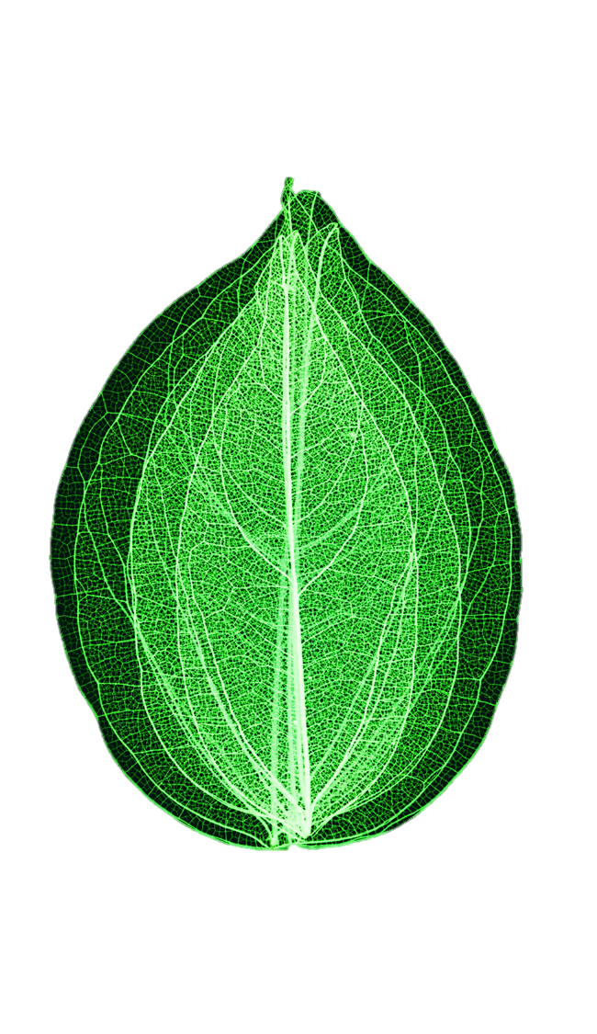
Dataset
The dataset utilized in this study was obtained from Kaggle, a well-known website for hosting and exchanging datasets pertaining to numerous fields. The dataset was specifically chosen to aid in the identification of wheat rust in leaf photos. It is essential for assessing how well deep learning models including InceptionV3 perform at detecting various wheat rust diseases, such as brown rust, yellow rust, and healthy leaves

Slide 14
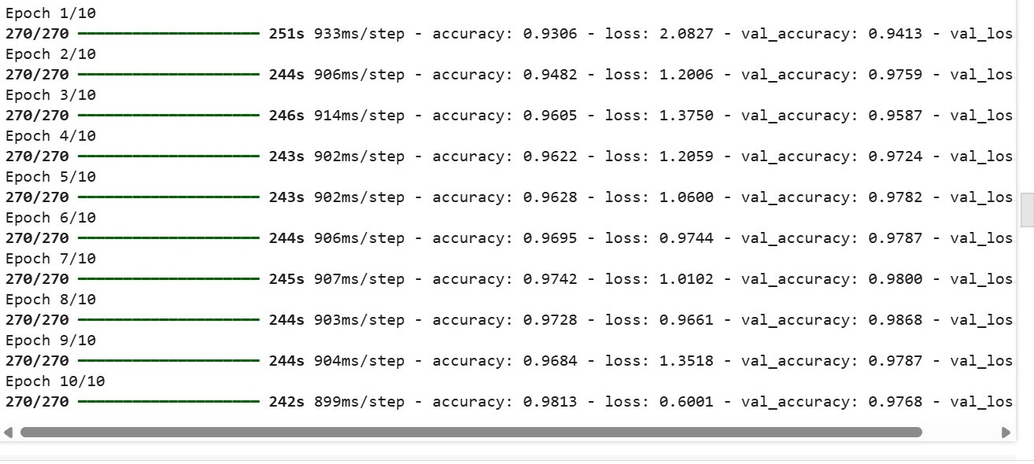
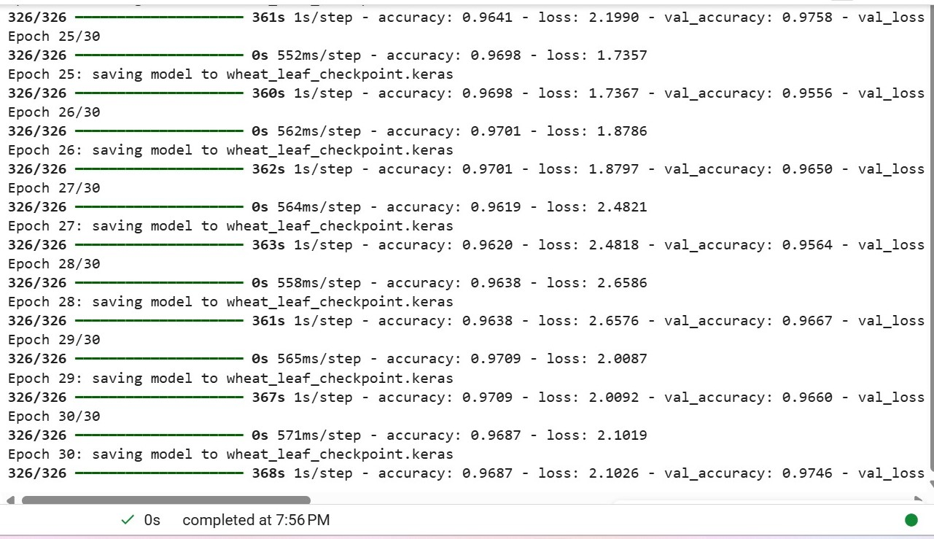
Results
Experimental results in detecting yellow, brown, and black rust demonstrate commendable accuracy rates for (98%).

Slide 15
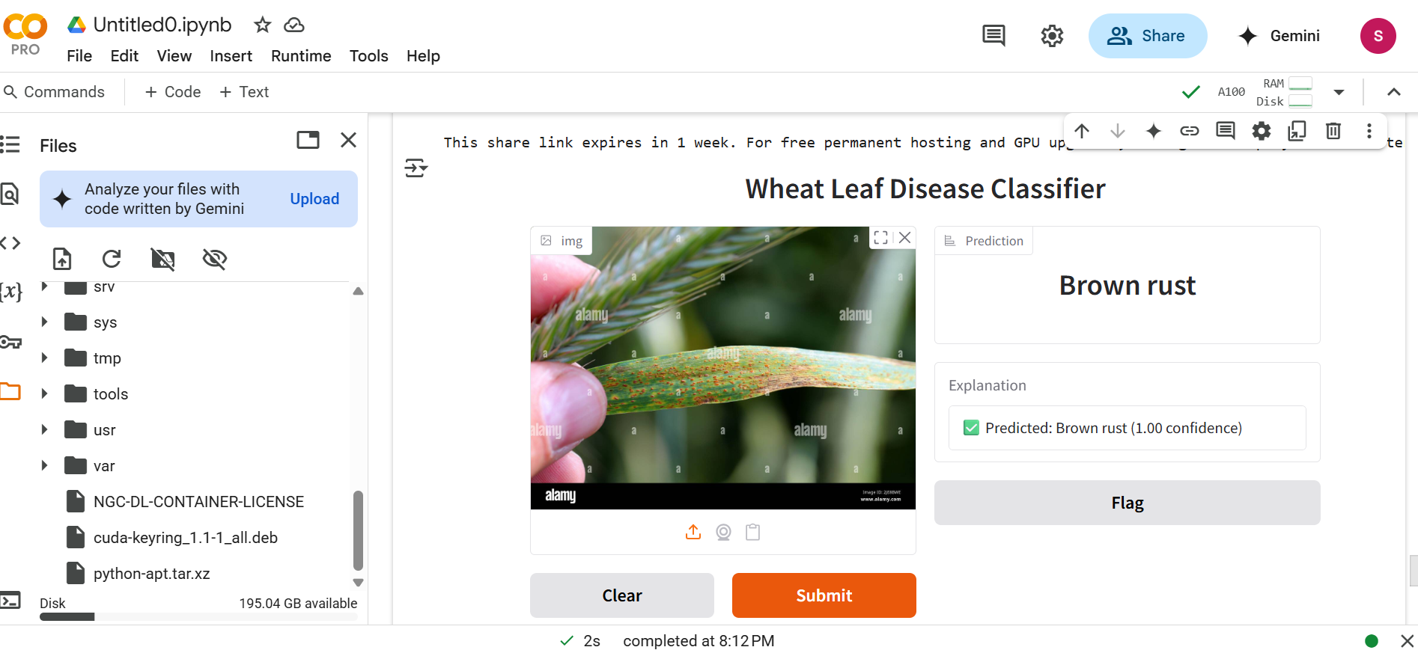
Results
When the model achieved its max accuracy, we test it using gradio.

Slide 16
Conclusion and Recommendations
The research, utilizing a dataset of 5000 wheat leaf images, showcased the models' accuracy in identifying brown rust, yellow rust, black rust and healthy leaves. Rigorous preprocessing and augmentation improved generalization, and models achieved high accuracy, with InceptionV3 at 98%. The study underscores their potential in advancing agricultural disease detection.

Slide 17
Future Work and Enhancement
Broader Disease Coverage: Extend the model to detect other wheat diseases and apply it to additional crops.
Mobile App Development: Launch an offline-capable mobile application for field use in remote areas.
Multilingual Support: Add language options to serve diverse farming populations.
Severity Detection: Refine the system to estimate disease severity levels for more precise treatment advice.
Weather Data Integration: Combine with weather forecasting systems to predict and prevent outbreaks in advance.

Slide 18
Thank You

